Slide 1
Unit – 2 (Syllabus)
ITE404 - Data Warehousing and Data Mining

Slide 2
Introduction to Data Mining
ITE404 - Data Warehousing and Data Mining

Slide 3
Why Data Mining?
The Explosive Growth of Data: from terabytes to petabytes
  Data collection and data availability
    Automated data collection tools, database systems, Web, computerized society
  Major sources of abundant data
    Business: Web, e-commerce, transactions, stocks, …
    Science: Remote sensing, bioinformatics, scientific simulation, …
    Society and everyone: news, digital cameras, YouTube
We are drown in data, but starving for knowledge!
We are data rich, but information poor.
“Necessity is the mother of invention”—Data mining—Automated analysis of massive data sets
ITE404 - Data Warehousing and Data Mining

Slide 4
Evolution of Sciences
Before 1600, empirical science
1600-1950s, theoretical science
  Each discipline has grown a theoretical component. Theoretical models often motivate experiments and generalize our understanding.
1950s-1990s, computational science
  Over the last 50 years, most disciplines have grown a third, computational branch (e.g. empirical, theoretical, and computational ecology, or physics, or linguistics.)
  Computational Science traditionally meant simulation. It grew out of our inability to find closed-form solutions for complex mathematical models.
1990-now, data science
  The flood of data from new scientific instruments and simulations
  The ability to economically store and manage petabytes of data online
  The Internet and computing Grid that makes all these archives universally accessible
  Scientific info. management, acquisition, organization, query, and visualization tasks scale almost linearly with data volumes. Data mining is a major new challenge!
Jim Gray and Alex Szalay, The World Wide Telescope: An Archetype for Online Science, Comm. ACM, 45(11): 50-54, Nov. 2002
ITE404 - Data Warehousing and Data Mining

Slide 5
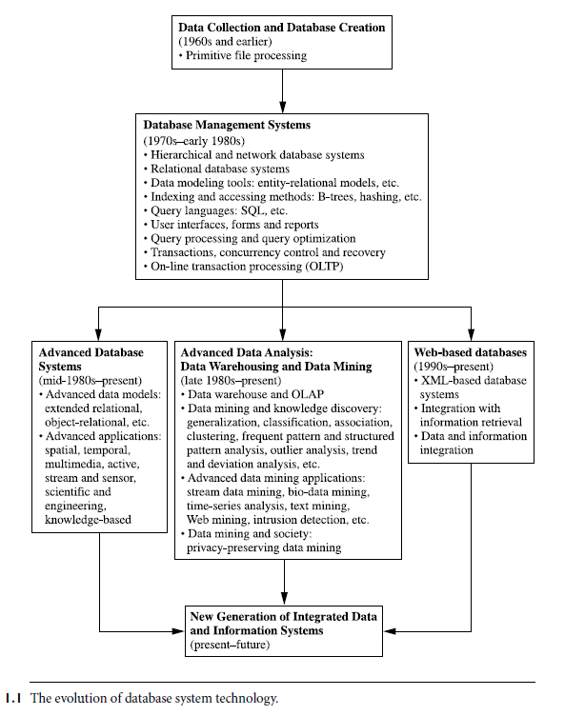
ITE404 - Data Warehousing and Data Mining

Slide 6
Evolution of Database Technology
1960s:
  Data collection, database creation, IMS and network DBMS
1970s:
  Relational data model, relational DBMS implementation
1980s:
  RDBMS, advanced data models (extended-relational, OO, deductive, etc.)
  Application-oriented DBMS (spatial, scientific, engineering, etc.)
1990s:
  Data mining, data warehousing, multimedia databases, and Web databases
2000s
  Stream data management and mining
  Data mining and its applications
  Web technology (XML, data integration) and global information systems
ITE404 - Data Warehousing and Data Mining

Slide 7


What Is Data Mining?
Data mining (knowledge discovery from data)
  Extraction of interesting (non-trivial, implicit, previously unknown and potentially useful) patterns or knowledge from larger amount of data
  Data mining: a misnomer?
  The mining of gold from rocks or sand is referred to as gold mining rather than rock or sand mining.
  The mining of coal from rocks or sand is referred to as coal mining.
ITE404 - Data Warehousing and Data Mining

Slide 8
What Is Data Mining?
Alternative names
  Knowledge discovery (mining) in databases (KDD), knowledge extraction, data/pattern analysis, data archeology, data dredging, information harvesting, business intelligence, etc.
Data mining—searching for knowledge (interesting patterns) in your data.
ITE404 - Data Warehousing and Data Mining

Slide 9
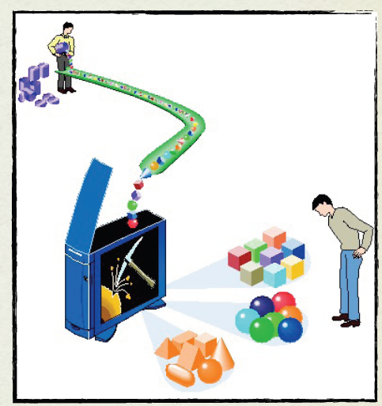
KDD: A Definition
Simply stated, data mining refers to extracting or “mining” knowledge
from large amounts of data, usually
automatically gathered
ITE404 - Data Warehousing and Data Mining

Slide 10



KDD: A Definition
KDD is the automatic or semi-automatic
extraction of non-obvious, hidden knowledge from large volumes of data.
10⁶-10¹² bytes:
we never see the whole
data set, so will put it in
the memory of computers
What is the knowledge?
How to represent
and use it?
Then run Data
Mining algorithms
ITE404 - Data Warehousing and Data Mining

Slide 11



Data, Information, Knowledge
We often see data as a string of bits, or numbers and symbols, or “objects” which we collect daily.
Information is data stripped of redundancy, and reduced to the minimum necessary to characterize the data.
Knowledge is integrated information, including facts and their relations, which have been perceived, discovered, or learned as our “mental pictures”.
Knowledge can be considered data at
a high level of abstraction and generalization.
ITE404 - Data Warehousing and Data Mining

Slide 12
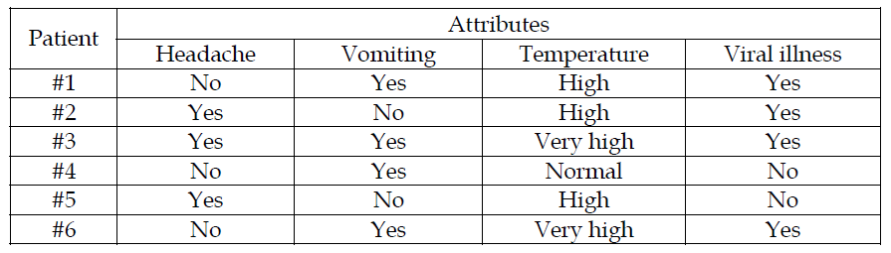
From Data to Knowledge
Numerical attribute categorical attribute missing values class labels
If (Headache=No AND Vomiting = Yes AND Temperature = High)
THEN Viral illness = Yes
ITE404 - Data Warehousing and Data Mining

Slide 13

Data Rich Knowledge Poor
How to acquire knowledge for
knowledge-based systems
remains as the main difficult
and crucial problem.
People gathered and stored so much data because they think some valuable assets
are implicitly coded within it.
?
knowledge
base
inference
engine
Raw data is rarely of direct benefit.
Its true value depends on the ability to extract information useful for decision support.
Tradition: via knowledge engineers
Impractical Manual Data Analysis
New trend: via automatic programs
ITE404 - Data Warehousing and Data Mining

Slide 14
Knowledge Discovery (KDD) Process
Knowledge
  Data mining—core of knowledge discovery process
Pattern Evaluation
Data Mining
Task-relevant Data
Data Warehouse
Selection
Data Cleaning
Data Integration
Databases
ITE404 - Data Warehousing and Data Mining

Slide 15
KDD Process - Steps
1. Data cleaning (to remove noise and inconsistent data)
2. Data integration (where multiple data sources may be combined)
3. Data selection (where data relevant to the analysis task are retrieved from the database)
4. Data transformation (where data are transformed or consolidated into forms appropriate for mining by performing summary or aggregation operations)
5. Data mining (an essential process where intelligent methods are applied in order to extract data patterns)
6. Pattern evaluation (to identify the truly interesting patterns representing knowledge based on some interestingness measures)
7. Knowledge presentation (where visualization and knowledge representation techniques are used to present the mined knowledge to the user)
ITE404 - Data Warehousing and Data Mining

Slide 16
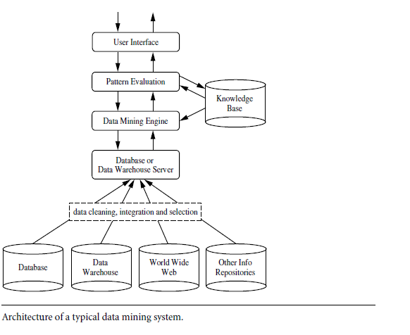
Architecture of Typical Data Mining System
ITE404 - Data Warehousing and Data Mining

Slide 17
Architecture of a typical data mining system
Database, data warehouse, World Wide Web, or other information repository:
  One or a set of databases, data warehouses, spreadsheets, or other kinds of information repositories.
  Data cleaning and data integration techniques may be performed on the data.
Database or data warehouse server:
  Responsible for fetching the relevant data, based on the user’s data mining request.
ITE404 - Data Warehousing and Data Mining

Slide 18
Contd….
Knowledge base:
  Knowledge is used to guide the search or evaluate the interestingness of resulting patterns.
  knowledge can include concept hierarchies, used to organize attributes or attribute values into different levels of abstraction.
  Knowledge such as user beliefs, which can be used to assess a pattern’s interestingness based on its unexpectedness, may also be included.
ITE404 - Data Warehousing and Data Mining

Slide 19
Contd…
Data mining engine:
  Consists of a set of functional modules for tasks such as characterization, association and correlation analysis, classification, prediction, cluster analysis, outlier analysis, and evolution analysis.
Pattern evaluation module:
  To focus the search toward interesting patterns.
  To filter out discovered patterns.
  The pattern evaluation module may be integrated with the mining module, depending on the implementation of the data mining method used.
  For efficient data mining, it is highly recommended to push the evaluation of pattern interestingness as deep as possible into the mining process so as to confine the search to only the interesting patterns.
ITE404 - Data Warehousing and Data Mining

Slide 20
Contd….
User interface:
  Communicates between users and the data mining system
  Allow the user to interact with the system by specifying a data mining query or task
  Provide information to help focus the search
  Performing exploratory data mining based on the intermediate data mining results.
  Allow the user to browse database and data warehouse schemas or data structures, evaluate mined patterns, and visualize the patterns in different forms.
ITE404 - Data Warehousing and Data Mining

Slide 21
Data Mining and Business Intelligence
Increasing potential
to support
business decisions
End User
Decision Making
Data Presentation
Business
Analyst
Visualization Techniques
Data Mining
Data
Analyst
Information Discovery
Data Exploration
Statistical Summary, Querying, and Reporting
Data Preprocessing/Integration, Data Warehouses
Data Sources
DBA
Paper, Files, Web documents, Scientific experiments, Database Systems
ITE404 - Data Warehousing and Data Mining

Slide 22
Data Mining: Confluence of Multiple Disciplines
Database
Technology
Statistics
Machine
Learning
Data Mining
Visualization
Pattern
Recognition
Other
Disciplines
Algorithm
ITE404 - Data Warehousing and Data Mining

Slide 23
Contd….
DM → an interdisciplinary field
Set of disciplines including database systems, statistics, machine learning, visualization, and information science.
Other disciplines → Neural networks, fuzzy logic or rough set theory, knowledge representation, etc.
ITE404 - Data Warehousing and Data Mining

Slide 24
Statistics is the study of the collection, organization, analysis, interpretation and presentation of data.
Machine learning, a branch of artificial intelligence, concerns the construction and study of systems that can learn from data.
For example, a machine learning system could be trained on email messages to learn to distinguish between spam and non-spam messages. Ex- trees, neural n/w etc.
A database is an organized collection of data.
ITE404 - Data Warehousing and Data Mining

Slide 25
AI
Artificial intelligence (AI) is technology and a branch of computer science that studies and develops intelligent machines and software.
Pattern recognition aims to classify data (patterns) based on either a priori knowledge or on statistical information extracted from the patterns.
ITE404 - Data Warehousing and Data Mining

Slide 26
Data Mining: Classification Schemes
General functionality
  Descriptive data mining
  Predictive data mining
Different views, different classifications
  Kinds of databases to be mined
  Kinds of knowledge to be discovered
  Kinds of techniques utilized
  Kinds of applications adapted
ITE404 - Data Warehousing and Data Mining

Slide 27
Data Mining
Prediction Methods
  using some variables to predict unknown or future values of other variables
Descriptive Methods
  finding human-interpretable patterns describing the data
ITE404 - Data Warehousing and Data Mining
Notes:
Time series: regression or occasionally classification problems on time varying data.
DB Segmentation: groupings into sub-problems, normally by a single feature
Clustering: similarity of cases, based on a multiple features. Exploratory analysis, often before clear prediction goals are established. Results are tentative

Slide 28
Why Not Traditional Data Analysis?
Tremendous amount of data
  Algorithms must be highly scalable to handle such as tera-bytes of data
High-dimensionality of data
  Micro-array may have tens of thousands of dimensions
High complexity of data
  Data streams and sensor data
  Time-series data, temporal data, sequence data
  Structure data, graphs, social networks and multi-linked data
  Heterogeneous databases and legacy databases
  Spatial, spatiotemporal, multimedia, text and Web data
  Software programs, scientific simulations
New and sophisticated applications
ITE404 - Data Warehousing and Data Mining

Slide 29
Multi-Dimensional View of Data Mining
Data to be mined
  Relational, data warehouse, transactional, stream, object-oriented/relational, active, spatial, time-series, text, multi-media, heterogeneous, legacy, WWW
Knowledge to be mined
  Characterization, discrimination, association, classification, clustering, trend/deviation, outlier analysis, etc.
  Multiple/integrated functions and mining at multiple levels
Techniques utilized
  Machine learning, statistics, visualization, etc.
Applications adapted
  Retail, telecommunication, banking, fraud analysis, bio-data mining, stock market analysis, text mining, Web mining, etc.
ITE404 - Data Warehousing and Data Mining

Slide 30
Multi-Dimensional View of Data Mining
Data to be mined
  Relational
  Data warehouse
  Transactional
  Stream
  Object-oriented
  Temporal Databases, Sequence Databases, and Time-Series Databases
  Spatial and Spatiotemporal
  Heterogeneous Databases and Legacy Databases
  Text and multi-media
  WWW
ITE404 - Data Warehousing and Data Mining

Slide 31
1. Relational
A database system, also called a database management system (DBMS).
DBMS consists of a collection of interrelated data, known as a database.
A set of software programs to manage and access the data.
The software programs involve mechanisms for the definition of database structures; for data storage; for concurrent, shared, or distributed data access; and for ensuring the consistency and security of the information stored, despite system crashes or attempts at unauthorized access.
ITE404 - Data Warehousing and Data Mining

Slide 32
Contd…..
A relational database is a collection of tables, each of which is assigned a unique name.
Each table consists of a set of attributes (columns or fields) and usually stores a large set of tuples (records or rows).
Each tuple in a relational table represents an object identified by a unique key and described by a set of attribute values.
A semantic data model, such as an entity-relationship (ER) data model, is often constructed for relational databases.
An ER data model represents the database as a set of entities and their relationships.
ITE404 - Data Warehousing and Data Mining

Slide 33
2. Data warehouse
A repository of information collected from multiple sources, stored under a unified schema, and that usually resides at a single site.
Constructed via a process of data cleaning, data integration, data transformation, data loading, and periodic data refreshing.
“A data warehouse is a subject-oriented, integrated, time-variant, and nonvolatile collection of data in support of management’s decision-making process.”—W. H. Inmon
ITE404 - Data Warehousing and Data Mining

Slide 34
Contd…
Usually modeled by a multidimensional database structure
Each dimension corresponds to an attribute or a set of attributes in the schema
Each cell stores the value of some aggregate measure, such as count or sales amount.
The actual physical structure of a data warehouse may be a relational data store or a multidimensional data cube.
A data cube provides a multidimensional view of data and allows the pre-computation and fast accessing of summarized data.
ITE404 - Data Warehousing and Data Mining

Slide 35
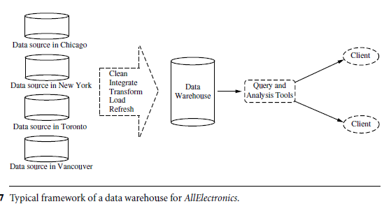
Contd…
ITE404 - Data Warehousing and Data Mining

Slide 36
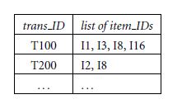
3. Transactional
Consists of a file where each record represents a transaction.
A transaction typically includes a unique transaction identity number (trans ID) and a list of the items making up the transaction (such as items purchased in a store).
ITE404 - Data Warehousing and Data Mining

Slide 37
The transactional database may have additional tables associated with it, which contain other information regarding the sale, such as the date of the transaction, the customer ID number, the ID number of the salesperson and of the branch at which the sale occurred, and so on.
ITE404 - Data Warehousing and Data Mining

Slide 38
4. Stream
data flow in and out of an observation platform (or window) dynamically
Unique features:
  huge or possibly infinite volume
  dynamically changing
  flowing in and out in a fixed order
  allowing only one or a small number of scans
  demanding fast (often real-time) response time.
ITE404 - Data Warehousing and Data Mining

Slide 39
4. Stream
Typical examples of data streams include various kinds of scientific and engineering data, time-series data, and data produced in other dynamic environments, such as power supply, network traffic, stock exchange, telecommunications, Web click streams, video surveillance, and weather or environment monitoring.
ITE404 - Data Warehousing and Data Mining

Slide 40
5. Object-oriented
Each entity is considered as an object
Objects that share a common set of properties can be grouped into an object class.
Each object is an instance of its class.
Object classes can be organized into class/subclass hierarchies so that each class represents properties that are common to objects in that class.
For instance, an employee class can contain variables like name, address, and birthdate.
ITE404 - Data Warehousing and Data Mining

Slide 41
Contd…
Suppose that the class, sales person, is a subclass of the class, employee.
A sales person object would inherit all of the variables pertaining to its superclass of employee.
In addition, it has all of the variables that pertain specifically to being a salesperson (e.g., commission).
Such a class inheritance feature benefits information sharing.
ITE404 - Data Warehousing and Data Mining

Slide 42
6. Temporal Databases, Sequence Databases, and Time-Series Databases
A temporal database typically stores relational data that include time-related attributes. These attributes may involve several timestamps, each having different semantics.
A sequence database stores sequences of ordered events, with or without a concrete notion of time. Examples include customer shopping sequences, Web click streams, and biological sequences.
A time-series database stores sequences of values or events obtained over repeated measurements of time (e.g., hourly, daily, weekly). Examples include data collected from the stock exchange, inventory control, and the observation of natural phenomena (like temperature and wind).
ITE404 - Data Warehousing and Data Mining

Slide 43
7. Spatial and Spatiotemporal
Spatial databases contain spatial-related information.
Examples include geographic (map) databases, very large-scale integration (VLSI) or computed-aided design databases, and medical and satellite image databases.
Spatial data may be represented in raster format, consisting of n-dimensional bit maps or pixel maps.
For example, a 2-D satellite image may be represented as raster data, where each pixel registers the rainfall in a given area.
Maps can be represented in vector format, where roads, bridges, buildings, and lakes are represented as unions or overlays of basic geometric constructs, such as points, lines, polygons, and the partitions and networks formed by these components.
ITE404 - Data Warehousing and Data Mining

Slide 44
Contd….
A spatial database that stores spatial objects that change with time is called a spatiotemporal database, from which interesting information can be mined. For example,
we may be able to group the trends of moving objects and identify some strangely moving vehicles, or distinguish a bioterrorist attack from a normal outbreak of the flu based on the geographic spread of a disease with time.
ITE404 - Data Warehousing and Data Mining

Slide 45
8. Heterogeneous Databases and Legacy Databases
A heterogeneous database consists of a set of interconnected, autonomous component databases.
A legacy database is a group of heterogeneous databases that combines different kinds of data systems.
The heterogeneous databases in a legacy database may be connected by intra or inter-computer networks.
ITE404 - Data Warehousing and Data Mining

Slide 46
9. Text and multi-media
Text databases are databases that contain word descriptions for objects.
Words, sentences or paragraphs (product specifications, error or bug reports, warning messages, summary reports, notes, or other documents).
may be highly unstructured (such as some Web pages on theWorldWideWeb).
ITE404 - Data Warehousing and Data Mining

Slide 47
Contd…
Some text databases may be somewhat structured, that is, semi-structured (such as e-mail messages and many HTML/XML Web pages),
Others are relatively well structured (such as library catalogue databases).
Text databases with highly regular structures typically can be implemented using relational database systems.
ITE404 - Data Warehousing and Data Mining

Slide 48
Contd….
(e.g.) Document classification
Multimedia databases store image, audio, and video data.
Used in applications such as picture content-based retrieval, voice-mail systems, video-on-demand systems, the World Wide Web, and speech-based user interfaces that recognize spoken commands.
It must support large objects, because data objects such as video can require gigabytes of storage.
ITE404 - Data Warehousing and Data Mining

Slide 49
10. WWW
Distributed information services, such as Yahoo!, Google, America Online, and AltaVista, provide rich, worldwide, on-line information services, where data objects are linked together to facilitate interactive access.
Users seeking information of interest traverse from one object via links to another.
Capturing user access patterns in such distributed information environments is called Web usage mining (or Weblog mining).
ITE404 - Data Warehousing and Data Mining

